Slide 1
WCSSF Rec Plus COACHES MEETING Spring 2024

Slide 2
Introduction
First of all and most important, please know that you are appreciated for the time that you give to help each player reach their best potential. We are thankful for each one of you!
We have a few things that we would like to go over to help us continually get better each season.
We ask that you help us emphasize the importance of sportsmanship, not only with the players, but with parents as well.
We had a record number of teams and coaches this season, which made scheduling very difficult.
Please remember that it is just a game, and when coaching these kids, it’s about more than just winning and losing, we are teaching them life lessons.
Our website has plenty of Information as well fyi, wcssf.org.
This Powerpoint will be sent out to your club’s rec plus coordinator.
For All of your home games, we encourage your club to have a board representative at the game. (other than a coach of that game)

Slide 3
Basics
SPRING 2024 | 11 & Under | 13 & Under | 15 & Under | 19 & Under (Spring Only)
Format | 7 v 7 | 9 v 9 | 11 v 11 | 11 v 11
Team Size to start game | Min. 5 | Min. 6 | Min. 7 | Min. 7
Roster size | Max 12 | Max 16 | Max 18 | Max 22 rostered, 18 dressed
Max. # of Players when including Select Pass Players | 11 | 13 | 15 | 15
Birthyears Allowed | 2013, 2014, 2015 | 2011, 2012, 2013 | 2009, 2010, 2011 | 2005 – 2009
Player Passes & Roster | Yes | Yes | Yes | Yes
Goal Size (ft) | 6 x 12 or 6.5 x 18.5 | 6.5 x 18.5 | 8 x 24 | 8 x 24
Ball Size | 4 | 4 | 5 | 5
Game Length (Minutes) | 2 X 25 | 2 x 30 | 2 x 35 | 2 x 40
Break Time (Minutes) | 5 | 10 | 10 | 10
Officials | 1 or 3 Officials | 3 Officials | 3 Officials | 3 Officials
Official Fees | $40 for 1; $60 (24/18/18) for 3 | $114 (50/32/32) | $154 (66/44/44) | $162 (70/46/46)
Offside | Yes | Yes | Yes | Yes
Headers | No Intentional Heading | No Intentional Heading | Yes | Yes
Punt/Drop Kicks | NO | Yes | Yes | yes
Build-Out Lines | No | No | No | No

Slide 4
Game goals for the League
To allow kids a safe and fun place to play soccer.
To constantly encourage each player to push themselves to their full potential whatever that may be.
To teach players the value of teamwork and sportsmanship.
To help players learn how to graciously accept winning or losing.
Make sure they enjoy their time as youth soccer players, because it is not always about winning.
- Some kids get burnt out on sports because they are pushed too hard….

Slide 5
Games & Roster notes
Player Passes MUST be in hand for the first games, this upcoming weekend, and they need to be laminated.
Coaches have the right to review the other team's player cards, this includes Coach passes.
Only 3 adults max are allowed on the sideline for a game, per team.
Also Keep a laminated copy of your roster as well.
Print off the match card for that game, which is available in GotSport. (See snip on later slide)
19U roster note: 22 can be rostered, but only 18 can dress for a game.
Home team provides min. 3 game balls for the match.
Keep a copy of the rules with you to your games. (WCSSF.org)
Away team and referees have 30 minutes to arrive to a game past the scheduled game time, fyi. Home team has 15 minutes. (a forfeit, if neither team arrives intime with the min. number of players to start)
- Do not wait, if either team has the min. number of players, you must start.

Slide 6
Game changes
The schedule was published this past Saturday 3-30-24. It will be the only schedule, No drafts. If there are conflicts or problems with your games, you will need to get into GOTSPORT and request a change with the team you are playing. Coach contact info is in GOTSPORT. (see snip)
When you make your request, PLEASE give other possible dates and times for the other team to check, in an effort to save time. If you are the HOME team make sure your Refs are available as well.
If you have to re-schedule due to weather, please do that asap. DO NOT wait until the end of the season.
This is the only way you will be able to change to your schedule at this point.
ALL CHANGES MUST BE IN GOTSPORT.

Slide 7
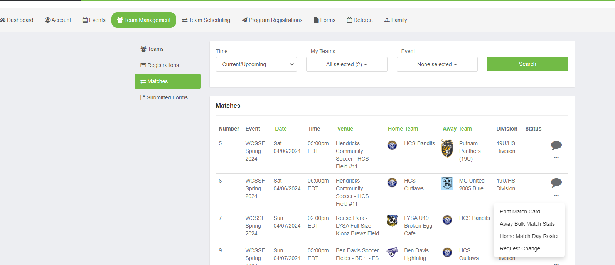
Match Card & game change request

Slide 8
Select Pass
Is intended only to get your team to the minimum roster. If your regular players show up, the select pass players must leave. See maximum players allowed in each division. If you feel a coach is violating this rule, you must bring it up to the Center Ref to check their cards.
11U - 11 max
13U - 13 max
15U - 15 max
19U - 15 max
You can use only rec plus players from within your club, NO TRAVEL players can be used for select pass.
You can also bring select pass players up from one division below.
- Example: 2009 is the oldest year for 15U, a 2009 player can be a select pass player on at 19U team)
Select pass is NOT accepted at the tournament, players must be rostered on the original roster for the tournament.
Questions?

Slide 9
Issues during the game
As a Coach, You are the leader of the team and set the tone for the entire match. Please make sure you set the expectation with your parents, prior to games, that they should only be saying encouraging words to your players. Not yelling at the refs, the other coaches or the other players.
We all like to win, but it is a game that is being played for fun. Not because they expect to go to world cup for the next game. It is only Rec Plus.
You can always take video of the game if there are concerns with a coach, parent or referee.
Then send a copy to wcssfsoccer@gmail.com Any issues should be emailed to this address.
- Please include the GOTSPORT game number if you are aware of it.
Remember that each person on the pitch sees things from a different perspective, The call is not going to change but the tone of the game can change based on your actions.
Winning is great but it is not everything. Games only last for 2 halves, but the lessons last a lifetime.

Slide 10
The Referees
Their job is to call the game according to what they see from their point of view. Let them ref the game, they don’t need your help from the sidelines.
We are losing MORE AND MORE referees each year than we are training. That means a lot of these refs are barely older than the kids playingthe game.
They are doing their best to call the game to the best of their ability. We are always in need of referees so if you don’t like the job they are doing, PLEASE get your certification so that you can come help ref.
If you don’t agree with a call, please refrain from yelling and / or arguing with the referee during the game. At half time or at the end of a game, politely and professionally talk to the referees.
If you have concerns, please email your specific concerns to wcssfsoccer@gmail.com and we will address them within 24 hours.
(include the Gotsport game number if you know it)

Slide 11
Final comments
Make sure that you, as well as your game referees, know who is there to represent your club during your game, should any issues arise.
Referees will input the game’s final score and cards, if any, in GotSport, but it is the coach’s responsibility to check the scores to make sure you agree with what was input.
Subbing: It is encouraged that subs on the sideline hold a pennie that distinguishes them as a sub when they are on the sideline. (subs that are standing up and moving around on the sideline can distract an AR from making an offsides call)
When a player subs on, the players will then exchange that pennie as they are entering and exiting the field….
Tournament is the weekend of May 18th.
Any Questions??

Slide 12
Thank you
For all of the time you invest in each player
For coaching with integrity
For giving your time for the benefit of the players
Email: Wcssfsoccer@gmail.com

